Slide 1
Healthcare Fraud
Exploratory Data Analysis
Hyejin Kim

Slide 2
Background
In 2020, healthcare spending accounting for over 19.7% of US GDP.
Losses due to fraud add $100 billion to the annual cost of healthcare in the US.
These losses affect everyone.
Businesses: increases cost of providing benefits to employees
Insured Patients: higher premiums/out of pocket expenses, reduced services
Notes:
Starting with a little background and why this is an important issue - The US healthcare industry is one of the largest in the country (in 2020, healthcare spending accounted for almost 20% of the country’s GDP) - https://www.insiderintelligence.com/insights/healthcare-industry/
It is an unfortunate reality that where there is money, there is fraudulent activity. And in healthcare, Although they make up a relatively small %, those fraudulent claims carry a very high price tag. In fact, it is estimated that losses due to fraud add $100 bill to annual cost of healthcare in the US.
These actions are losses to everyone. And so this is a problem that is undoubtedly a substantial.

Slide 3
What is Healthcare Fraud?
Types of fraud committed by providers:
Double billing: Submitting multiple claims for the same service
Unbundling: Submitting multiple bills for the same service
Phantom billing: Billing for a service visit or supplies the patient never received
Upcoding: Billing for a more expensive service than the patient actually received
Notes:
https://www.fbi.gov/scams-and-safety/common-scams-and-crimes/health-care-fraud#:~:text=Health%20care%20fraud%20is%20not,medical%20procedures%2C%20and%20increase%20taxes.

Slide 4
About the Data
Inpatient records: over 40k records, includes patient/provider/ doctor IDs, date of claim, date of admission, diagnosis & procedure code, cost/reimbursement, etc
Outpatient records: over 500k records
Beneficiary records: over 130k patients with demographic & chronic conditions
Providers with fraudulent flags: list of all providers indicating potential fraud
Notes:
Inpatient records: over 40k records, includes patient/provider/ doctor IDs, date of claim, date of admission, diagnosis & procedure code, cost/reimbursement, etc
Outpatient records had similar information without the admission details
Beneficiary records: over 130k patients with demographic & chronic conditions
Providers with fraudulent flags: list of all providers indicating potential fraud

Slide 5
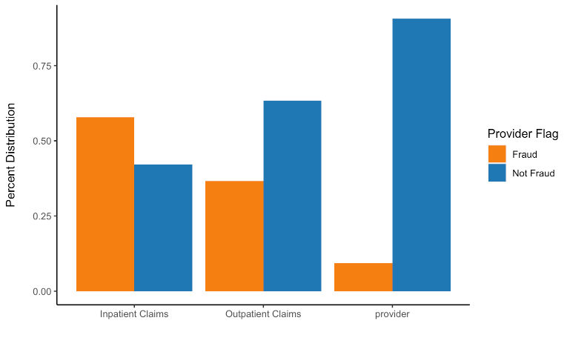
Distribution of Potential Fraud
Providers flagged as fraud only make up 9% of all Providers but make up for significant distribution of all claims
Notes:
Looking at these datasets, we find that Providers with fraudulent flags only made up about 9% of all providers. But these providers were responsible for a much higher share of the claims comparatively, especially within inpatient claims - we see that they’re responsible for over 50% of these claims.

Slide 6
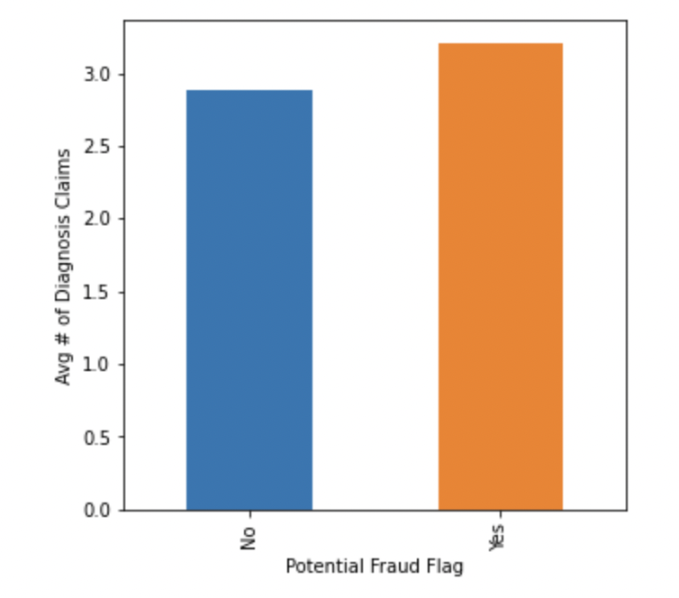
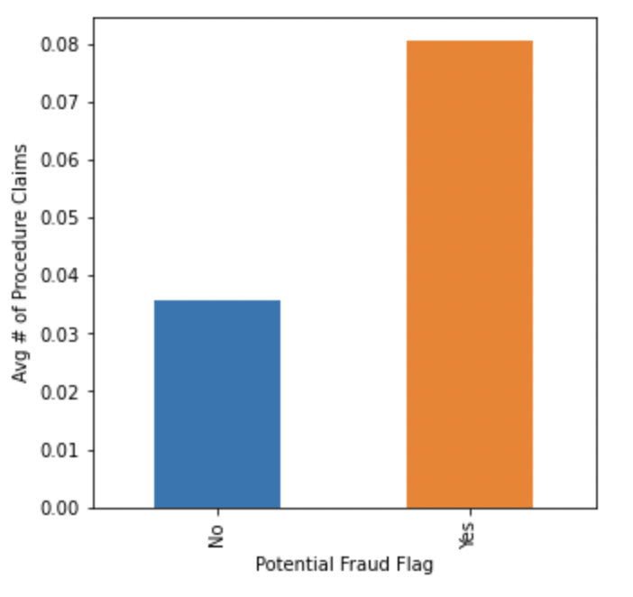
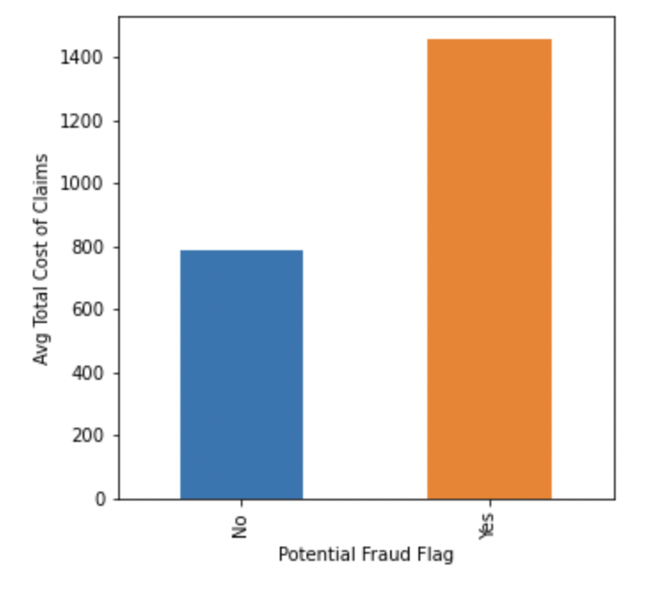
Provider comparisons
Diagnosis Claims Procedure Claims Total Costs of Claims
Notes:
In addition to distribution of patient claims, Looking at within each individual claim; providers that are flagged as fraud on avg make more diagnoses per claim, add more procedures per claim (so this may be indicative of signs of phantom billing or upcoding where patients are billed for a service they didnt receive). With more diagnosis and procedures billed per claim, we can see the financial impact is then also higher for these potentially fraudulent providers - their average claim reimbursements are about twice as high compared to non fraudulent providers.
These tables combine inpatient and outpatient data - so these are all aggregate means

Slide 7
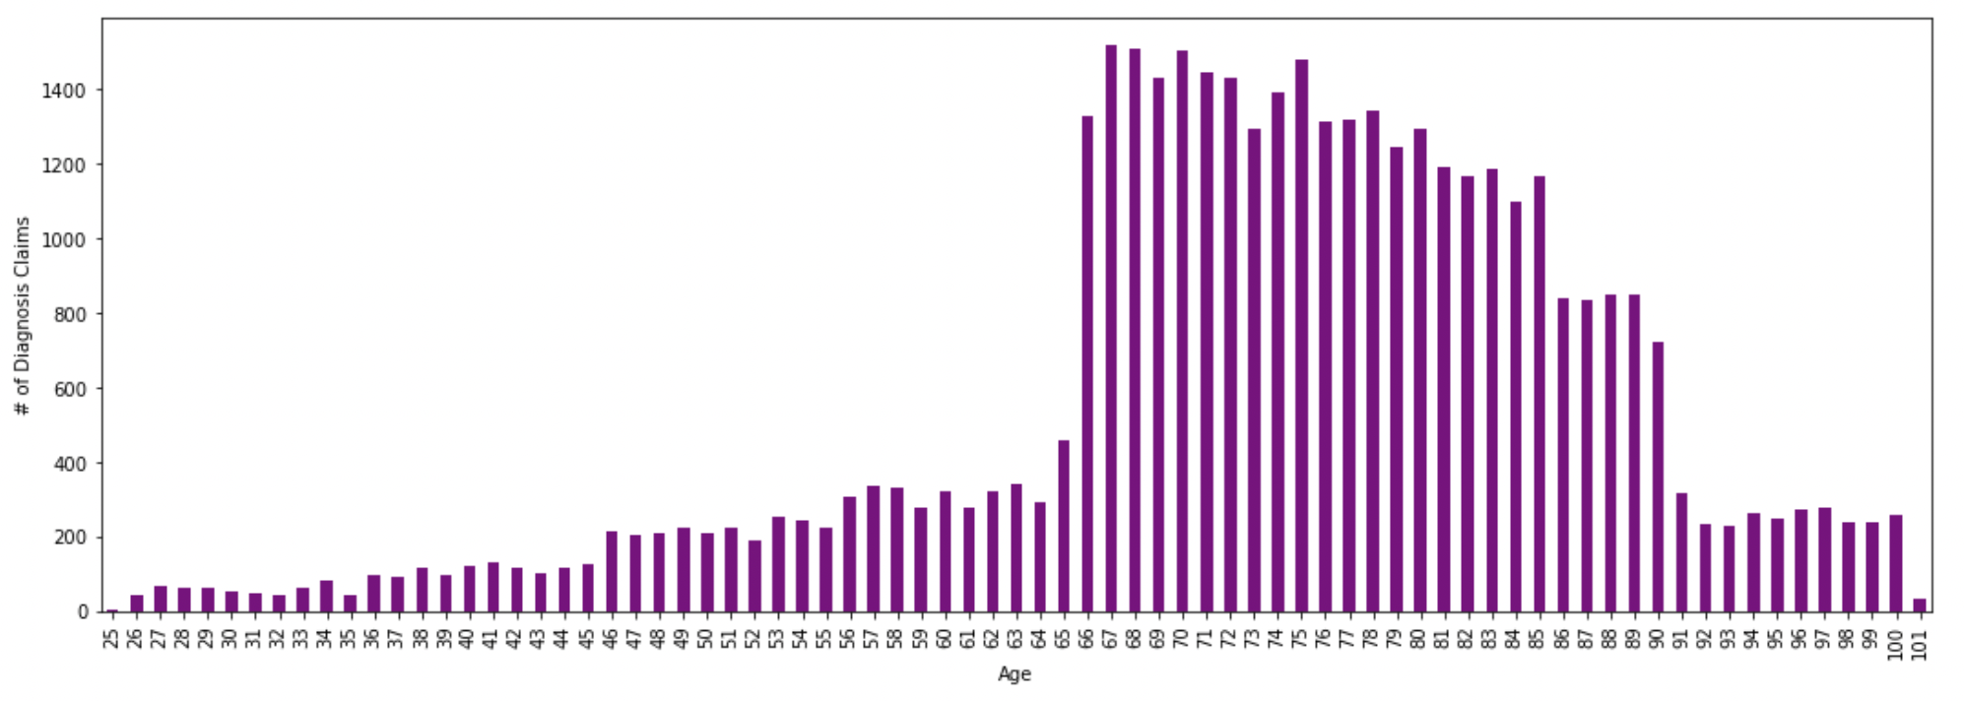
Patient EDA: Age
Distribution of total claim counts by age
Notes:
So looking at the general cost and claim process behavior amongst providers flagged as fraud vs. no fraud, there seems to be pretty clear signs that there is something these fraud flagged providers do as they seem to be processing more claims, more diagnosis & procedures per each claim, and making more money per claim.
So I wanted to take a look at the patient data to see if I could find any trends that would indicate whether or not there are certain populations that are more susceptible to fall victim to healthcare fraud. And if there were, that would be beneficial information for insurance companies for better fraud detection training but also for patients, for greater awareness.
Looking at the patient dataset, there are high number of claims for people age 66-90, Age 65 is also when seniors qualify for Medicare. In general, the elderly population are susceptible to fraud and with such a high spike in claims for this age group, I wanted to see if there was any indication that fraud providers were targeting them.

Slide 8
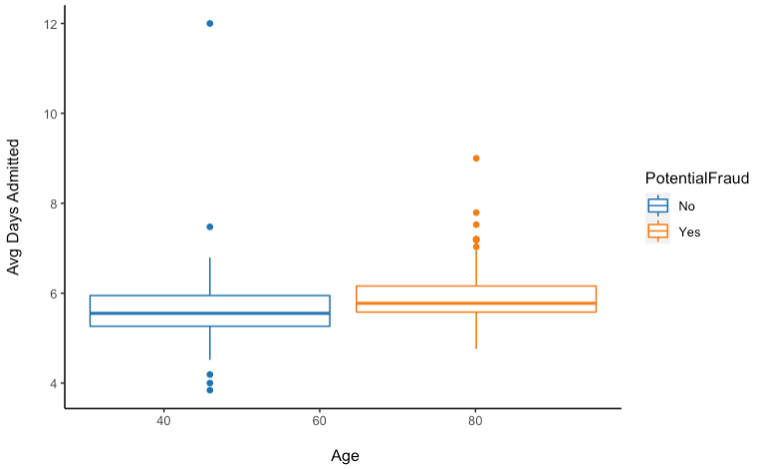
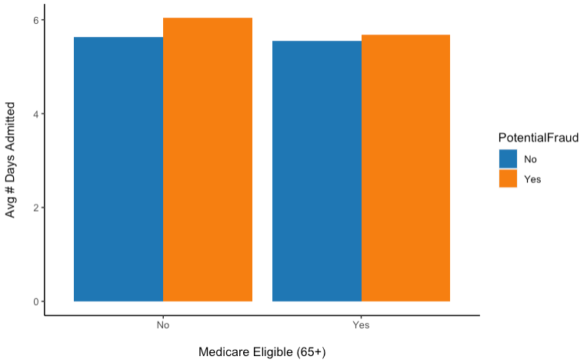
Are older populations at higher risk of being targeted for fraud?
No significant indication of higher number of Days Admitted for potentially Fraud providers for older population
Notes:
So we know that on avg, fraud providers file higher reimbursement per claim, processing more diagnosis codes and procedures codes. Inpatient claims were especially higher, so I wanted to see if that was due to longer hospital stays?
The next metric I looked at was # of days admitted. I wanted to see if there was any visible difference between fraud and non fraud providers - to see if there was any indication that they were either falsifying the # of days patients were hospitalized or keeping patients there longer to increase billing and reimbursements
This view is split up to compare age groups younger than 65 and older than 65 with a boxplot and barchart and In either cases, there doesnt seem to be a significant difference amongst the avg # of days admitted between fraud and non fraud providers overall or within the elderly population.

Slide 9
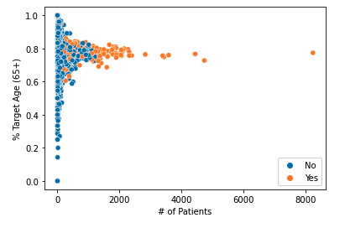
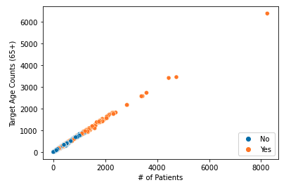
Do fraud providers have higher distribution of older patients?
Providers with higher likelihood of fraud seem to have higher volume of patients, but not necessarily more older patients
Notes:
Next, I wanted to see if fraud providers target older patients, by either duplicating their claims or faking their data - and if so, there would be higher distribution of older patients claims for these fraud providers.
On the left is the relationship for each provider, for the # of patients they have; what % of their patients are 65+.
It seems for non fraud providers, the distribution varies amongst providers; you have some that have few older patients and some that have higher amounts. For fraud providers, they seem to have some concentration in the higher percentages.
Aside from having a higher proportion of older patients, the strong indicator seems to be overall volume # of Patients, The more patients a provider has seems to be an indicator of fraud here.
And then on the right, instead of %, we see the same view in counts; and it pretty much paints the same picture; it seems like the stronger indication of fraud here is that these providers just have more patients which may be an indication of faked or duplicate claims.

Slide 10
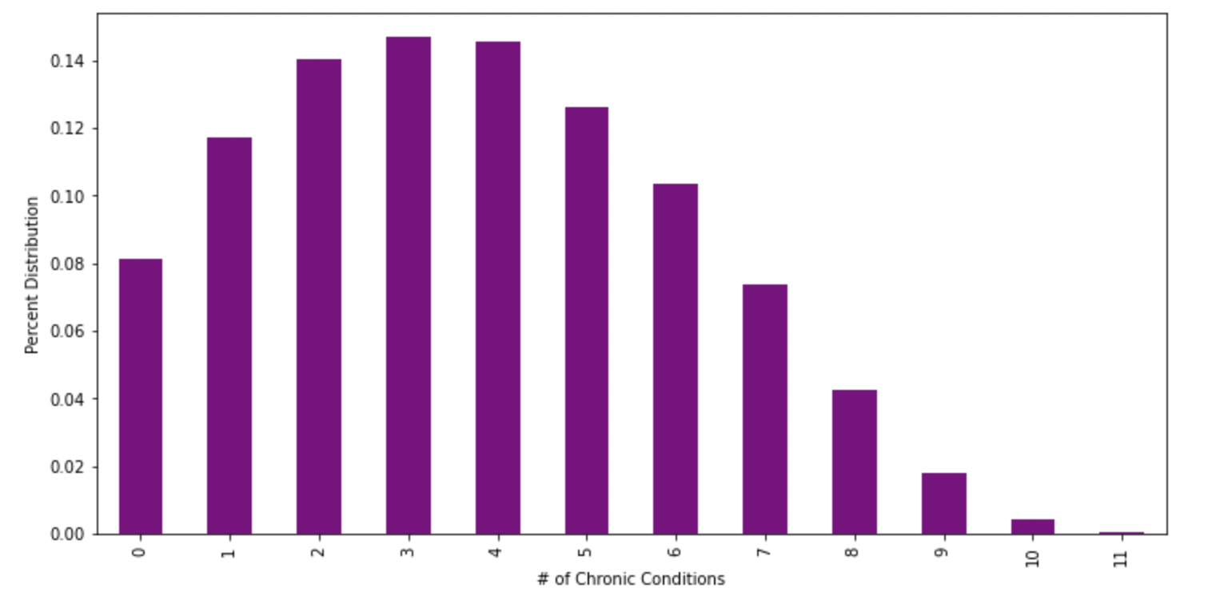
Patient EDA: Chronic Illnesses
Distribution of Patients and number of chronic illnesses
Notes:
The next patient population I looked that was patients with chronic illnesses.
I wondered if the more chronic illness a person has, are they more susceptible for fraud as something providers would use against them to charge for more services along with higher reimbursements?
From the patient dataset, there seems to be a significant amount of patients with at least 2+ chronic illnesses.

Slide 11
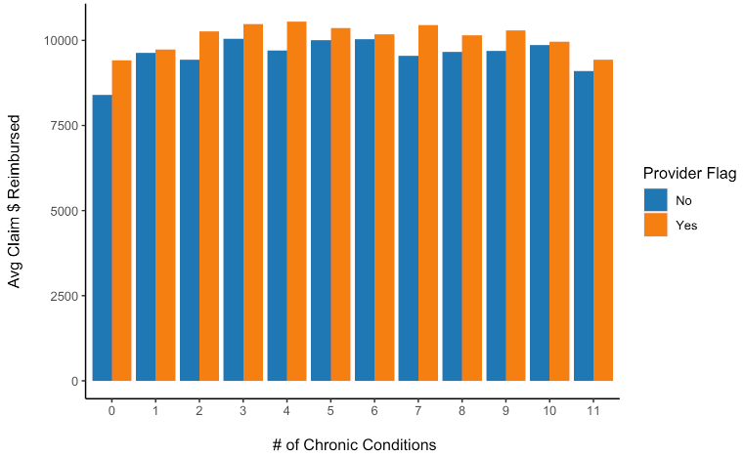
Are people with more chronic conditions targeted?
Providers with higher likelihood of fraud seem to have higher claim amounts, but not it does not seem any higher with more chronic conditions
Notes:
Looking at the comparison of avg costs for patients by # of chronic illnesses, it seems like in general fraud providers charge more per claim across the board but having more chronic conditions does not necessarily mean that the difference will be greater for patients with more chronic conditions.

Slide 12
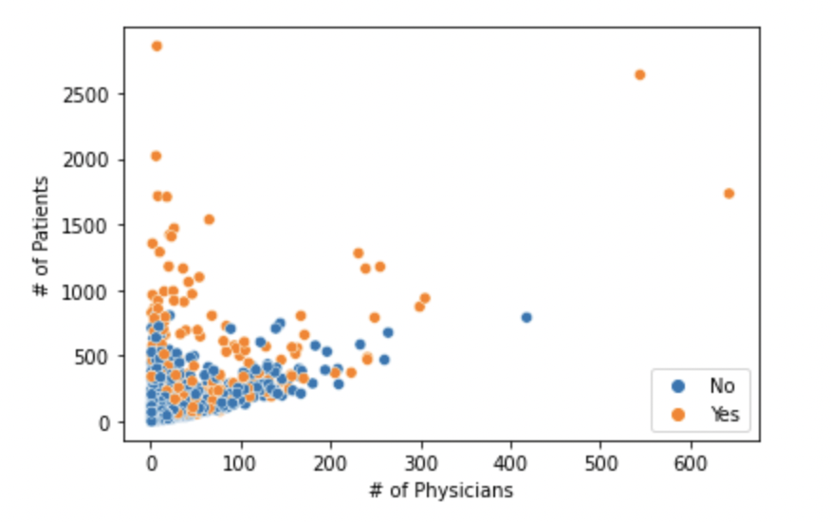
Provider Trends: Signs of Duplicate Claims
Providers that are flagged as fraud have high patient to physician ratio
Notes:
Lastly, I looked into provider specific trends to see if there was some characteristic amongst fraudulent providers that we can extrapolate that would be useful information for insurance companies to be aware of.
Here we see the relationship bw the number of patients and physicians for each provider. The providers that have relatively small # of physicians but very high patient count are more likely to be fraud. This might be an indication of providers who duplicate their patient claims (a provider with less than 20 physicians that have 2500 patients seem highly suspicious)

Slide 13
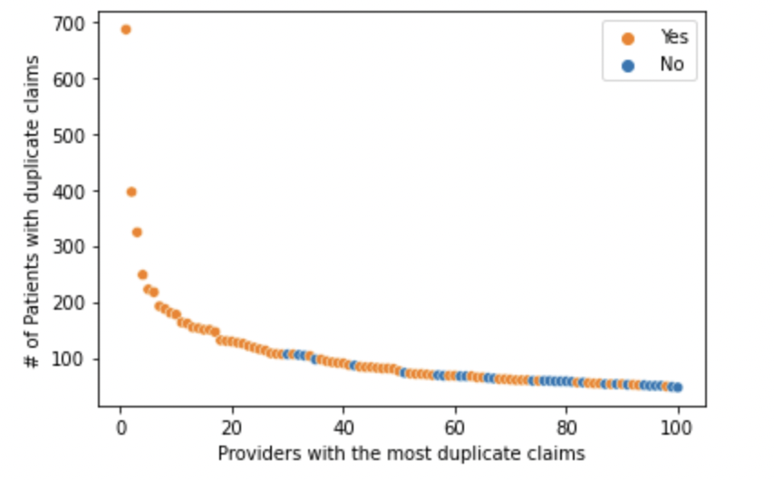
Provider Trends: Signs of Duplicate Claims
Providers with more duplicate patient claims are more likely to be flagged as fraud
Notes:
I then looked for a different type of duplicate claims. Specifically, instances where a provider charged a patient twice for the same amount. For example, if provider A charged patient B $5,000 in two separate claims. There could be valid reasons for this, for instance, if the patient had the same procedure done twice, or 2 different procedures that happen to cost the same amount but it also could be an indication that the provider is faking patient claims, especially if it happens a lot.
The chart here shows the top 100 providers who had the most duplicate claims of this type. The x axis here is by rank so the first point is the #1 provider who had almost 700 different patients with duplicate claims.
As you can, the providers with the most duplicate claims are all flagged for potential fraud. This makes sense to me. It is unlikely that a single provider has a reason to duplicate claims on 700 different occasions, particularly when most providers hardly ever have duplicate claims.

Slide 14
Conclusions
There is strong evidence of potential fraudulent providers, processing more claims/diagnosis/procedures, thus leading to higher claims amounts.
There was no clear indication whether there are specific populations that fraud providers target, there is likely a more sophisticated approach so that they are not flagged as easily
One of the strongest indicators were high patient volumes, providers with more patient claims and patients had higher likelihood of being fraud
Next Steps:
Explore more variables, diagnosis code to identify how providers may duplicate or upcode claims, identify characteristic thresholds; help insurance companies & patients for better awareness and ability to spot fraudulent activity

